Slide 1
Operators in C
Mohamed Rahman Shareff S

Slide 2
Operators
The symbols which are used to perform logical and mathematical operations in a C program are called C operators.
C supports a rich set of built in operators
Operators are classified into a number of categories:
1. Arithmetic Operators
2. Relational Operator
3. Logical Operator
4. Assignment Operator
5. Increment & Decrement Operator
6. Conditional Operator
7. Bitwise Operator
8. Special Operator (Sizeof())

Slide 3
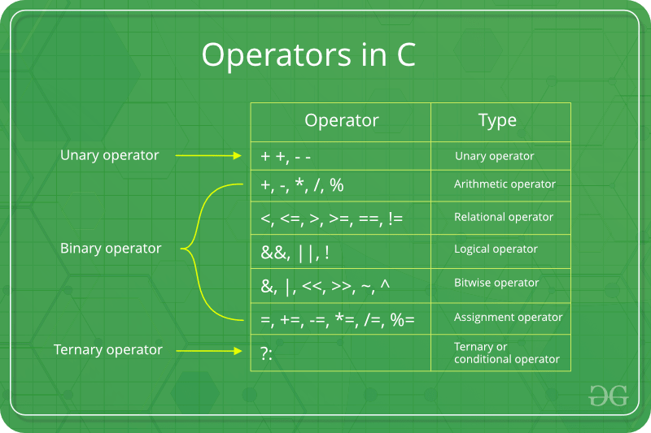

Slide 4
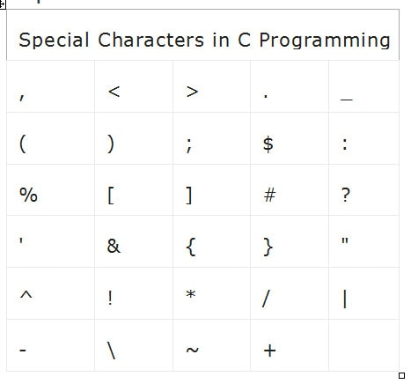
Special Symbols
The following special symbols are used in C having some special meaning and thus, cannot be used for some other purpose.

Slide 5
Arithmetic Operators
C Arithmetic operators are (+, -, *, / and %) used to perform addition, subtraction, multiplication, and division. They act as basic mathematical operations.
Where Unary arithmetic operator required only one operand such as +,-, ++, --,!, etc. And these operators are addition, subtraction, multiplication, division.
Binary arithmetic operator on other hand required two operand and its operators are +(addition), -(subtraction), *(multiplication), /(division), %(modulus).

Slide 6
Relational Operators
C Relational operators are (>,<,>=,<= and ==) used compare two operands for the validity of a relationship.
Here the value is assign according to true or false value.
a.(a>=b) || (b>20)
b.(b>a) && (e>b)
c. 0(b!=7)

Slide 7
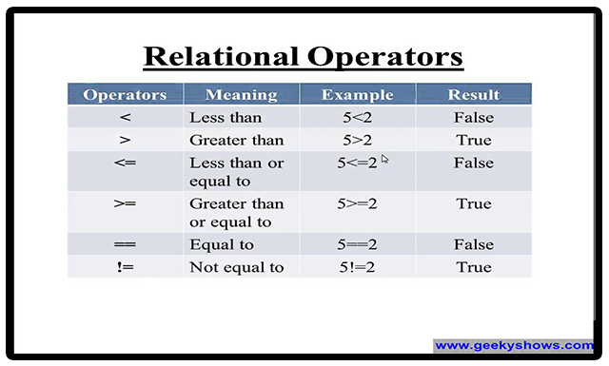
Relational Operators

Slide 8
Logical Operators
1. C Logical operators are (&&(and), ||(or) , !(not) )
2. Used to combine more than one operand or relational expressions.
3. An expression containing logical operator returns either 0 or 1 depending upon whether expression results true or false.
4. Logical operators are commonly used in decision making in C programming.

Slide 9
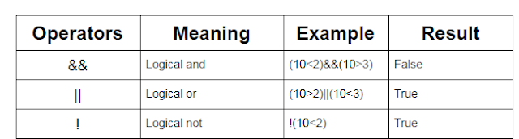
Logical Operators

Slide 10
Assignment Operator
An assignment operator is used for assigning a value to a variable.
The left side operand of the assignment operator is a variable and right side operand of the assignment operator is a value.
Assignment Operator is binary operator which operates on two operands.
Assignment Operator have Two Values : L-Value and R-Value

Slide 11
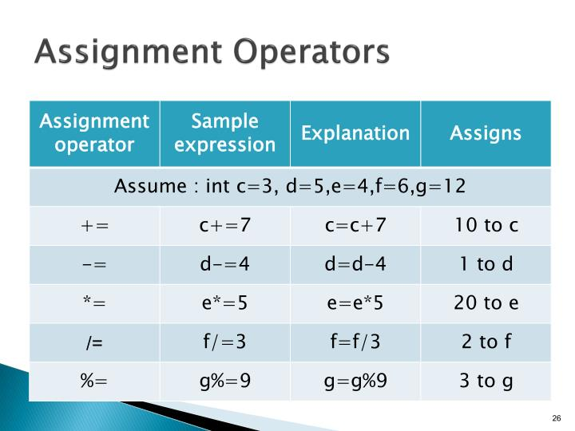
Assignment Operator

Slide 12
Increment & Decrement Operators
Increment and Decrement operators are (++ and -- ) used to incrementing /decrementing a value by one.
Syntax: Increment operator: ++var_name; (or) var_name++; Decrement operator: – -var_name; (or) var_name – -;
Example: Increment operator : ++ i ; i ++ ; Decrement operator : – – i ; i – – ;

Slide 13
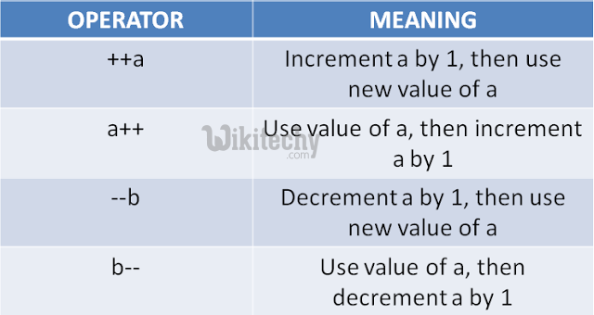
Increment & Decrement Operators

Slide 14
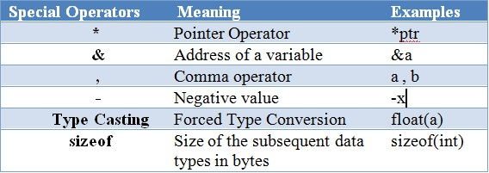
Special Operators

Slide 15
Bitwise Operators
A bitwise operator is an operator used to perform bitwise operations on bit patterns or binary numerals that involve the manipulation of individual bits.
Bitwise operations performed on bit flags, which can enable an instance of enumeration type to store any combination of values defined in an enumerator list

Slide 16
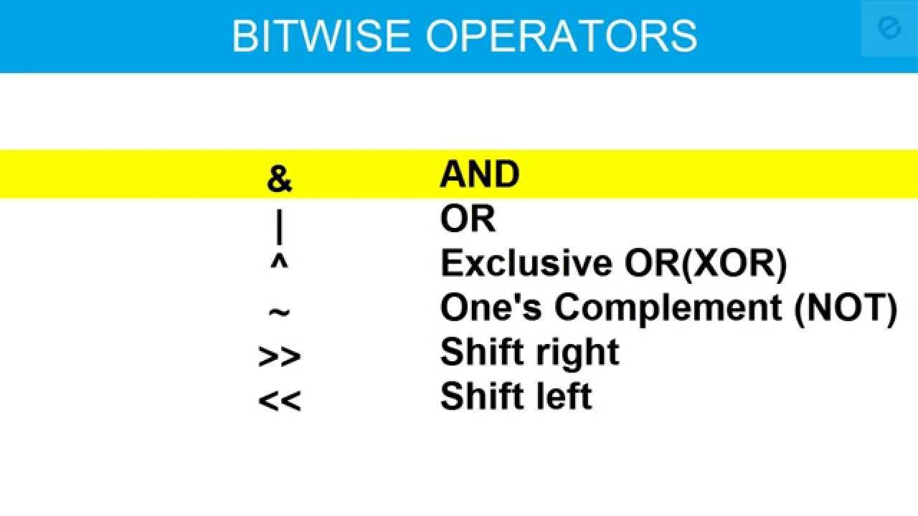
Bitwise Operators

Slide 17
Conditional Operator
We can also use ternary operator (? :) to perform the task of if...else statement. It is a shorthand way to check the condition.
Syntax
exp1?exp2:exp3;
If the exp1 condition is true, then exp2 will be executing otherwise exp3 will be executing.
Eg: large= (a>b)?a:b;

Slide 18
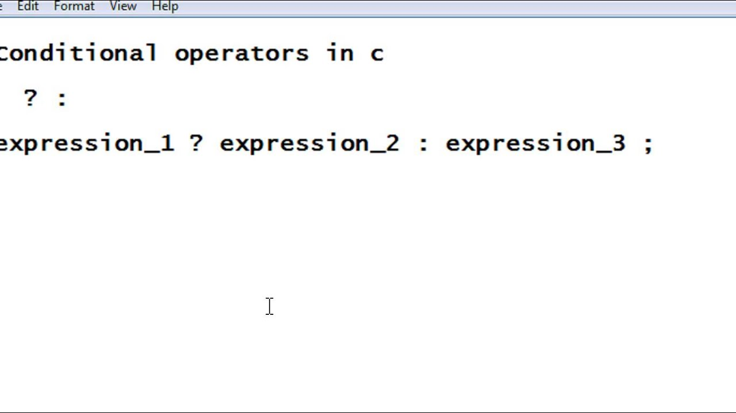
Conditional Operator

